Slide 1

Optimization of hydraulic fracturing design using data driven models
Team Members
MOHAMED ADEL GABRY ABDELSALAM | 2095451
SRI SAI HARSHA AMBATI | 2090997
SRIKANTH REDDY NIMMALA | 2100527
ANIRUDH PALLELARLA | 2100694
SAIVARDHAN REDDY NOMULA | 1799472
MADDIRALA VENKATA SATYA SAI SUJITH | 2146852

Slide 2
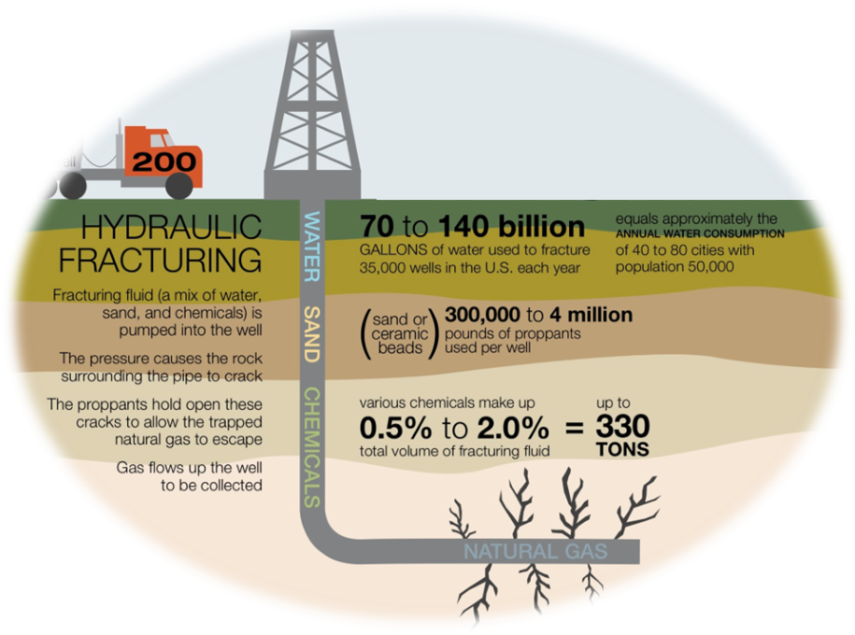
Problem Definition
Optimization of operational hydraulic fracturing parameters costs alot of money
•Proppant costs can range from $0.8 million to $1.8 million making up 6–25 per cent of well’s total cost.
•Frac fluid costs can range from $0.3 million to $1.2 million making up 5–19 per cent of well’s total cost.
•The total Frac pumping costs for all stages can range from $1.0 million to $2.0 million, making up 14–41 per cent of a well’s total cost.
The actual production is ⅓ production estimation of physics based models

Slide 3
For Every Frac designer
•What is the optimum proppant volume that is needed to be pumped?
• What is the optimum proppant size that is needed to be pumped?
•What is the best fracturing fluid additives to be used?
•What is the expected production performance when getting a higher fracture gradient or treating pressure?

Slide 4

Current Industry Workflow
Local Experience Rules
Continuous long Optimization Cycle
Reservoir data
Operational data
Fracture Simulator
Reservoir model
Production Estimation
Various Types and it doesn’t include all parameters like chemical effects with a lot of uncertainties
Analytical model (Provide Snapshot)
Numerical model (Expensive)
A lot of uncertainties
Try another operational variables

Slide 5
Solution
Build a machine learning model that links the production data with the operational parameters and reservoir parameters.
The project will be used to minimize the cost of material (proppant and fluid) to get the maximum possible productivity from the frac. Stage.
Investigate the effect of treating pressure, screenouts, and ISIP on post-fracture production to provide a tool for future hydraulic fracture optimization to get the best treatment for Marcellus formation.

Slide 6
Benefits
Data driven decisions based on the recorded data from fracture reports and production measurements.
Local experience is converted to machine learning model (Less human mistakes)
No need for core data, geo-mechanical parameters, or reservoir assumptions needed for fracture modeling and reservoir modeling.
Better optimization for hydraulic fracture operation.

Slide 7
Methodology
Business Problem
Data Collection
Data Conversion
Evaluation of models
Modelling
Preprocessing / Feature Engineering

Slide 8
Data Collection
Filenames | Format | Source
NNE Boggess 1H Compiled Report NNE Boggess 3H Compiled Report NNE Boggess 5H Compiled Report NNE Boggess 9H Compiled Report NNE Boggess 13H Compiled Report NNE Boggess 17H Compiled Report | PDF | Marcellus Shale Energy and Environment Laboratory

Slide 9
Tools used for Extraction
There are several open-source tools like Audit Command Language(ACL), Tabula(tool/python library),Spacy(Python library),Pypdf2(python library),Nanonets for pdf conversion into usable format.
Our sole target is to extract Boggess pad table with features but unfortunately the table is in image format in pdf files and the libraries in python doesn’t work on these tables.
We used
Nanonets – Table Extraction
Power Query Editor(Excel) – Transforming the extracted data into proper format.

Slide 10
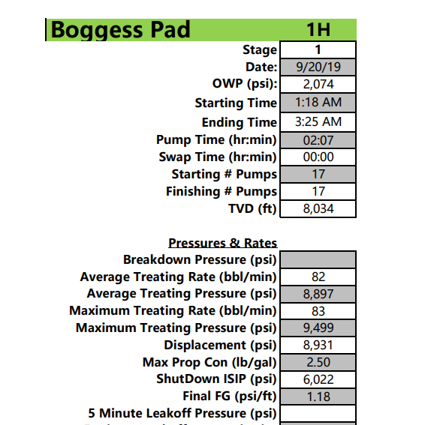
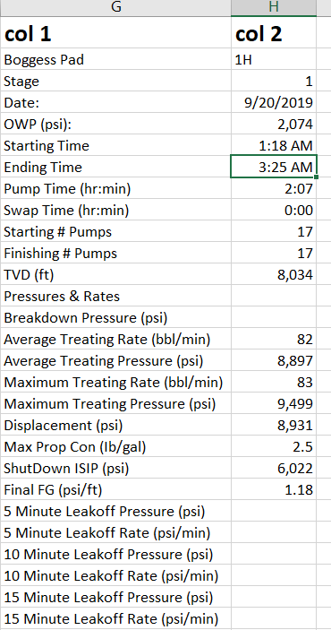
Data Extraction – Stage 1
Target Table in PDF
Extracted Table from pdf n Excel
Nanonets

Slide 11
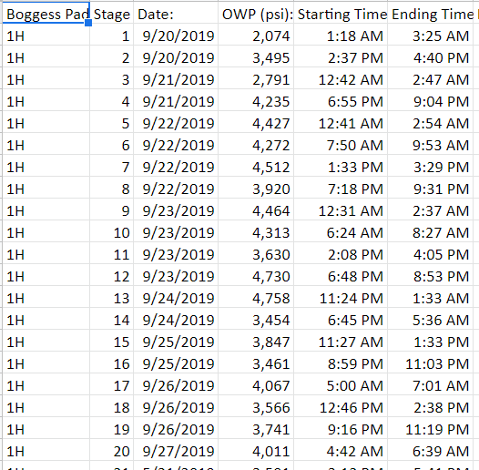
Data Extraction – Stage 2
Data Before Transformation
Final Dataset for Modelling
Power Query Editor

Slide 12
Features
Formation Features
Operational Features
Gamma Rays readings for each stage
Breakdown Pressure (psi)
Average Treating Rate (bbl/min)
Average Treating Pressure (psi)
Maximum Treating Rate (bbl/min)
Maximum Treating Pressure (psi)
Displacement pressure (psi)
5 Minute Leakoff Pressure (psi)
5 Minute Leakoff Rate (psi/min)
10 Minute Leakoff Pressure (psi)
10 Minute Leakoff Rate (psi/min)
15 Minute Leakoff Pressure (psi)
15 Minute Leakoff Rate (psi/min)
Max Prop Concentration (Ib/gal)
Shut Down ISIP (psi)
Final Frac Gradient (psi/ft)
Slick water (bbls)
Acid volume (7.5% HCL) (gal)
Wireline Pump Down volume (bbls)
Pad volume (bbls)
Proppant volume
Treatment (bbls)
Displacement (bbls)
(Acid Included) Total (bbls)
Dirty Job Total (bbls)
100 Mesh size volume
40/70 Mesh size volume
Total Proppant (Ibs)
Total Proppant % placed
FR 9800
Biocide add.
Scale add.
Target Features
Cumulative Production for 2 years
Constant Features for all stages
Reservoir Pressure
Reservoir Permeability
Reservoir fluid Properties
Bottomhole flowing pressure
Vertical variation of geomechanical parameters

Slide 13
Data Inspection
Collected 6 wells data on together we have around 340 stages.
After Extraction we have 43 columns/features and dropped 9 features.
Out of 34 features, there are missing values in 18 features for 316 stages/samples.
After Discussion with MSE, Filled missing values with Backward, Forward Fill, Median, Zero.

Slide 14
Target Variable Selection/Assigning values to Target Variable
Wells production data is recorded for over 2 years on daily basis.
Gas Production data is recorded for more than 500 days for each well.
As we have Frac Parameters for each stage, we need to split production over stages of that particular well.

Slide 15
Target Variable Selection/Assigning values to Target Variable
We are running the production for each well and for the total available production, we are generating random points as production for the stage in each well and these values are considered as target variables.
Due to time frame and limited sources, we used random points generation over the production for the stages in each well.
We used random split for target variable and splitted production over stages of each well.

Slide 16
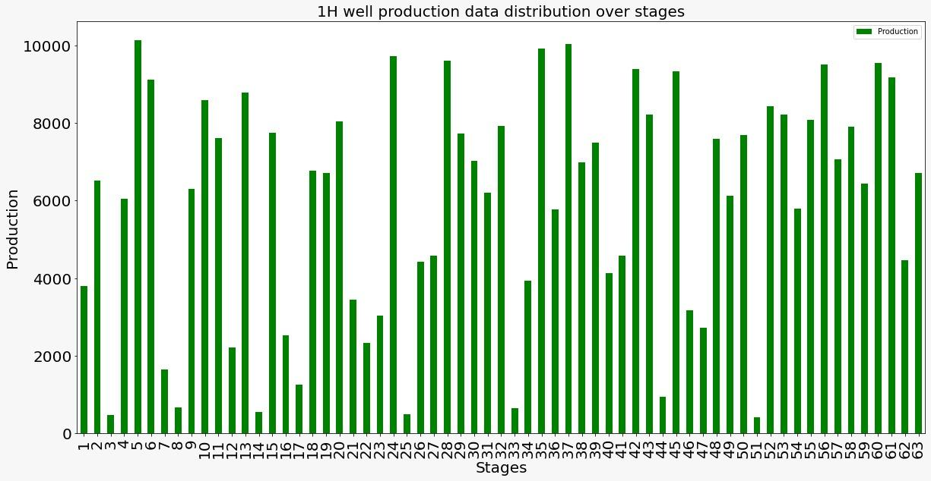
Distribution of Production among Stages in a Well using Random Split

Slide 17
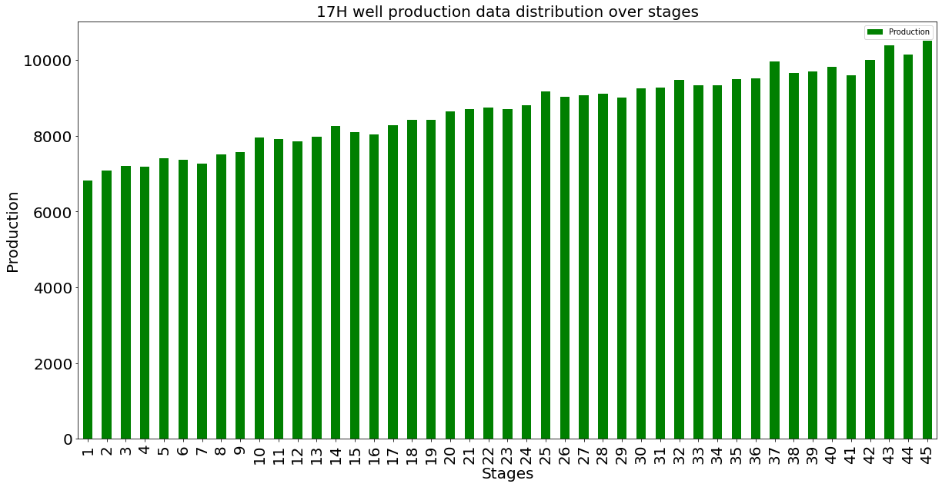
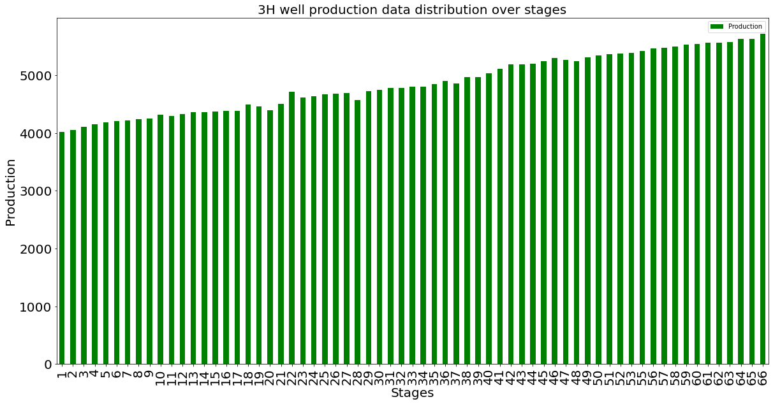
Distribution of Production among Stages in Each Well Using Uniform and Random Split

Slide 18
Dealing Missing Values
Missing Value Columns | Technique
Breakdown Pressure (psi) | Backward Fill
Displacement (psi) | Backward Fill
Wireline Pump Down (bbls) | Backward Fill
Displacement (bbls) | Backward Fill
ShutDown ISIP (psi) | Backward Fill
Final FG (psi/ft) | Filled with Median Values
(Acid Included) Total (bbls) | Filled with Median Values
Dirty Job Total (bbls) | Filled with Median Values
40/70', 'FR 9800' | Filled with Zeros

Slide 19
Dealing Missing Values
Missing Value Columns | Technique
Biocide', 'Scale' | Filled with Zeros
5 Minute Leakoff Pressure (psi) | Filled with Backward and Forward
5 Minute Leakoff Rate (psi/min) | Filled with Backward and Forward
10 Minute Leakoff Pressure (psi) | Filled with Backward and Forward
10 Minute Leakoff Rate (psi/min) | Filled with Backward and Forward
15 Minute Leakoff Rate (psi/min) | Filled with Backward and Forward
15 Minute Leakoff Pressure (psi) | Filled with Backward and Forward

Slide 20
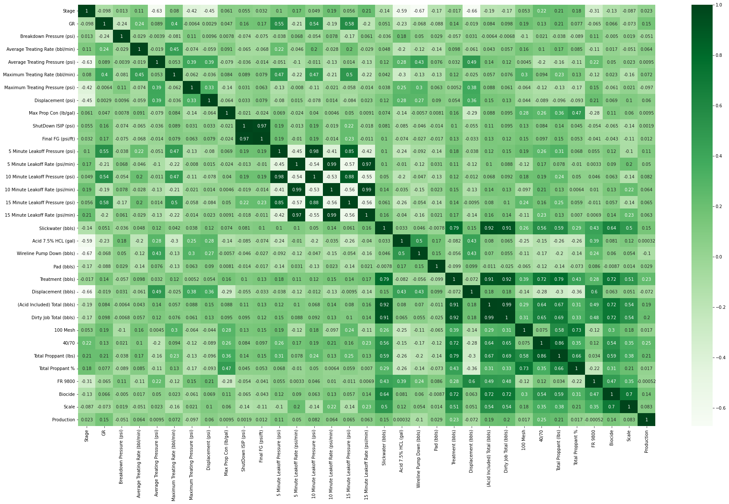
Correlation Matrix

Slide 21
Feature Engineering
According to the correlation matrix, these three features are highly correlated values, as shown below:
Shutdown ISIP (psi) and Final FG (psi/fft)
Shutdown ISIP (psi) and Total Acid Included (bbls)
Treatment (bbls) and Total Acid Included (bbls)
Treatment (bbls) and Dirty Job Total (bbls)
Slickwater (bbls) and Total Acid Included (bbls)
Slickwater (bbls) and Dirty Job Total (bbls)
Because the aforementioned features were highly related, we dropped Shutdown ISIP Acid Included Total, Dirty Job to obtain a stable regression model.

Slide 22
ML Modelling
These are the following models, which we have used:
Linear Regression
Lasso Regression
Ridge Regression
Support Vector Regression (SVR)
Decision Trees
Random Forest
KNN
Extra Trees
AdaBoost
LightGBM
CATBOOST

Slide 23
Model Evaluation
ML Model | R2 | MAE | RMSE
Linear Regression | -0.061537 | 619.25 | 1164.54
Lasso Regression | 0.0001 | 613.18 | 1129.19
Ridge Regression | -0.043 | 675.18 | 1154.34
SVR | 0.526 | 578.84 | 777.88
Decision Tree | 0.915 | 182.04 | 327.84
Random Forest | 0.953 | 136.25 | 244.01
KNN | 0.574 | 535.31 | 737.30
Extra Trees | 0.952 | 157.49 | 247.43
AdaBoost | 0.854 | 325.75 | 430.62
LightGBM | 0.951 | 165.24 | 248.97
CATBOOST | 0.958 | 146.76 | 230.24

Slide 24
Model Evaluation & Metrics
R2 ,Mean Absolute Error(MAE),Root Mean Squared Error(RMSE) are considered as metrics for Model evaluation in Regression.These metrics indicate the deviation of predicted values from actual values.
R2 explains to what extent the variance of one variable explains the variance of 2nd variable
Mean absolute error is the difference between actual and predicted estimates.
RMSE is the square root of squared difference of actual and predicted values.

Slide 25
Model Evaluation
CATBOOST has R2 0.958 which explains that the 90% of observed information can be explained by model inputs.
Extra trees has R2 value 0.952 & LightGBM R2 value 0.951 which is almost equal to CATBOOST but these models lags bit in MAE and RMSE compared to CATBOOST which has MAE 146.76 and RMSE 230.24
CATBOOST is considered as ideal or best model for predicting production based on input parameters.

Slide 26
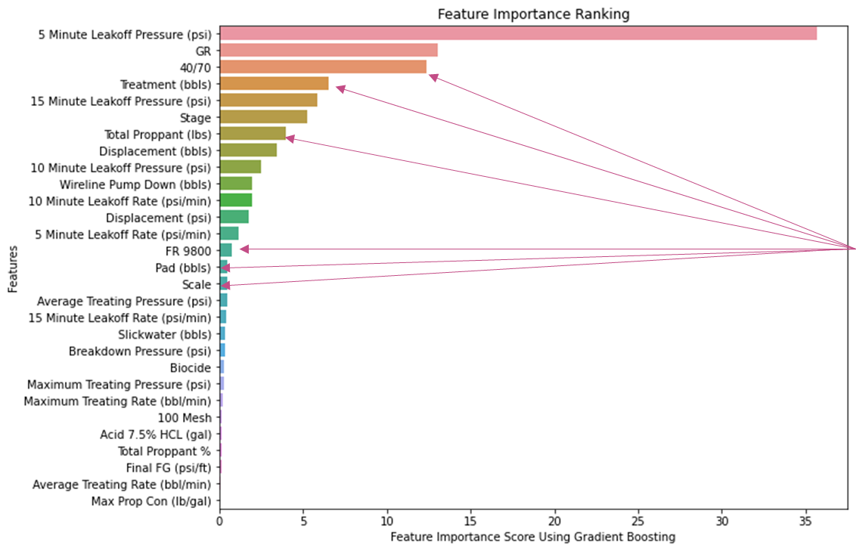
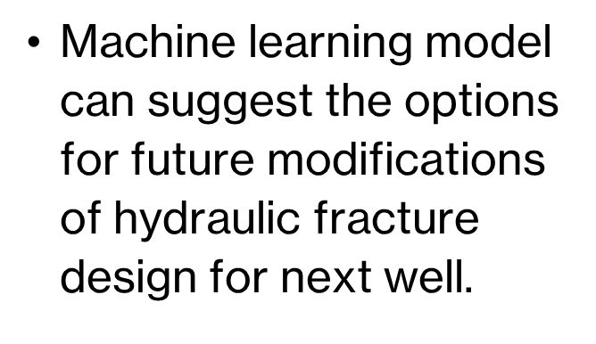
Conclusion
The problem can be further enhanced by implementing neural networks and the production can be forecasted and can be predicted by for the required number of days using time series methods

Slide 27
Challenges & Future Scope
•Availability of structured data for all hydraulic fracture jobs is the main challenge.
•Using chemical/radioactive tracers to monitor each stage of production can enhance model accuracy for better optimization.
Working with structured production data for can provide accurate estimated production curve for new wells.

